Slide 1
Satellite Imagery Hack Day
Martin Jung, Peter Hurley, Phil Rooney, Eduard Campillo-Fundollet, Jorn Scharlemann, Pedram Rowhani

Slide 2
Gaussian Processes for Change-point Detection in Satellite Imagery
More flexible
Handles missing data and uncertainty
Provides more information from data
What is a Gaussian Process?
Probabilistic, Non-parametric approach to modelling data

Slide 3
Want function to have:
Periodic component
Smoother longer term trend
The behavior of the functions are governed by `hyperparameters’
We either fix them or find them
With data points

Slide 4
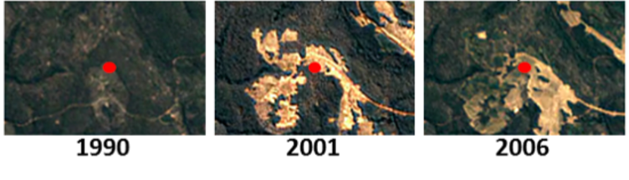
Gaussian Process applied to Landsat data
And applied to test set

Slide 5
Summary
Gaussian Processes have big potential for change-point detection
Works better
Handles missing/noisy data
Provides more information (e.g. period, scale at which long term changes are occurring etc.)
Can provide predictions
Additional possible avenues worth exploring:
Use multiband information rather than NDVI
How/where is this information useful for GCRF?

